Slide 1


LIVER DISEASE PREDICTION
MENTOR : VARUN VENNALAGANTI

Slide 2
Business Problem:
To predict the risk of liver disease in individuals.
Objective:
The objective of this project is to predict the risk of liver disease in individuals. It uses machine learning algorithms to predict the likelihood of a person developing liver disease based on health records.
Ultimately, the combination of clinical, laboratory and machine learning algorithms can be used to assess the risk of Liver Disease in individuals, and help to provide personalized interventions to help reduce the risk.

Slide 3
Project Architecture / Project Flow
Understanding Business Problem
Collection of data
Model deployment
Model building
Cleaning of data
Exploratory data analysis

Slide 4
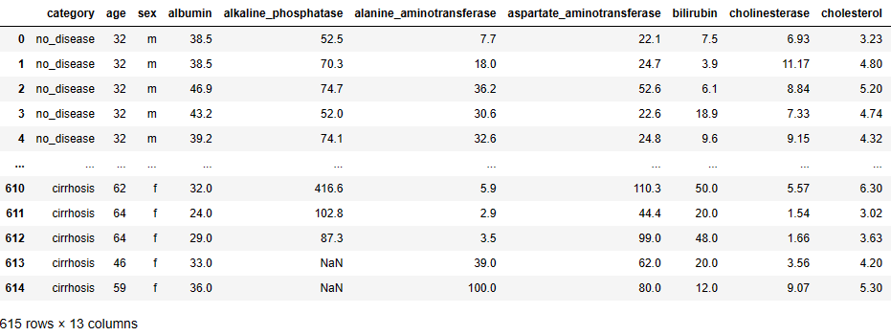
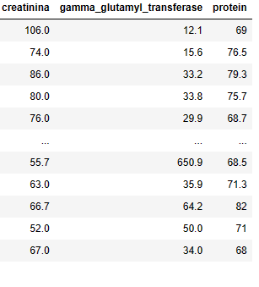
Dataset
Dataset has total 615 rows and 13 columns. Nearly all input variables are numeric-valued except sex, which is binary, and most of them represents measurements from blood and urine analysis. The following are the list of variables present in our dataset :
category, age, sex, albumin, alkaline_phosphatase, alanine_aminotransferase, aspartate_aminotransferase, bilirubin, cholinesterase, cholesterol, creatinine, gamma_glutamyl_tranferase, protein.

Slide 5
Exploratory Data Analysis (EDA)

Slide 6
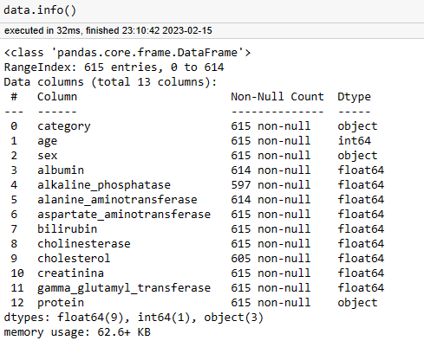
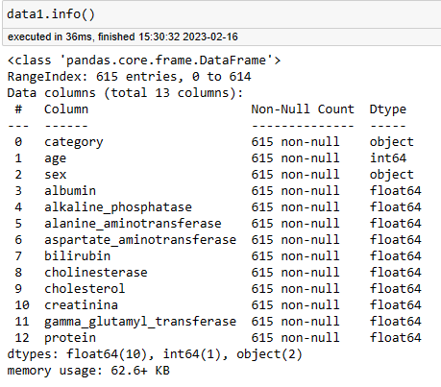
Before
After
Converted the datatype of protein column from string (Object) to numeric (Float). And filled the null values with mean of each column.

Slide 7
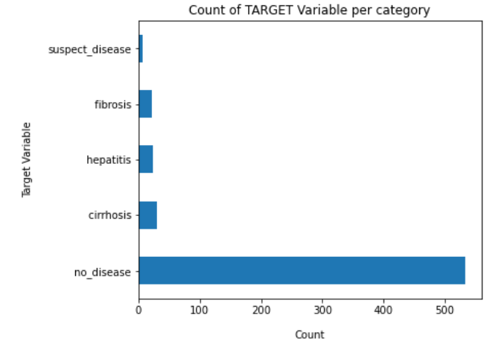
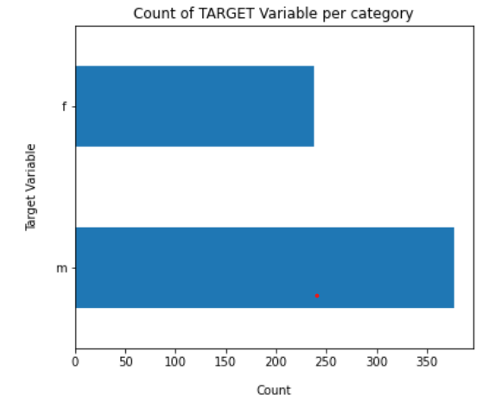
Count Plot for categorical variables
Indicates the number of observations for each category.

Slide 8
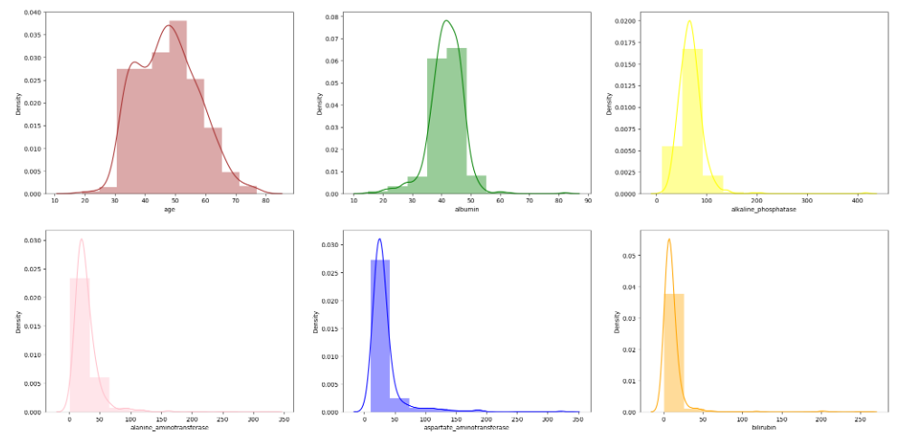
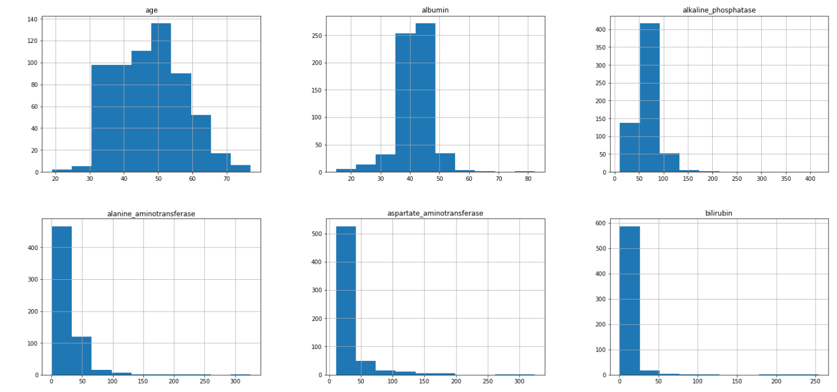
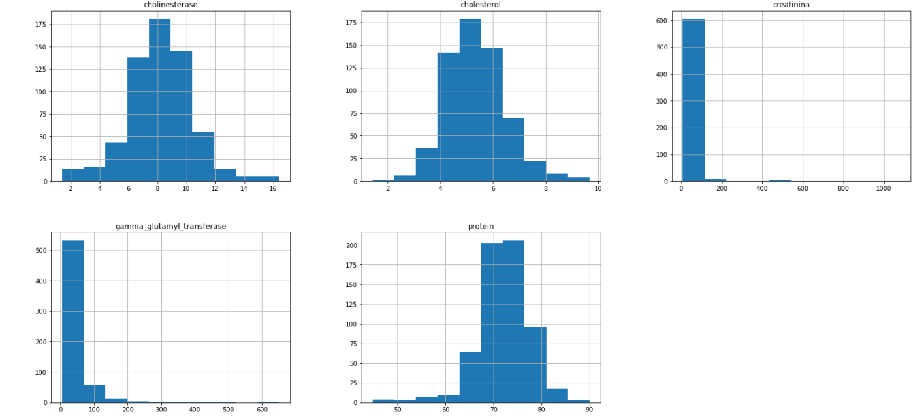
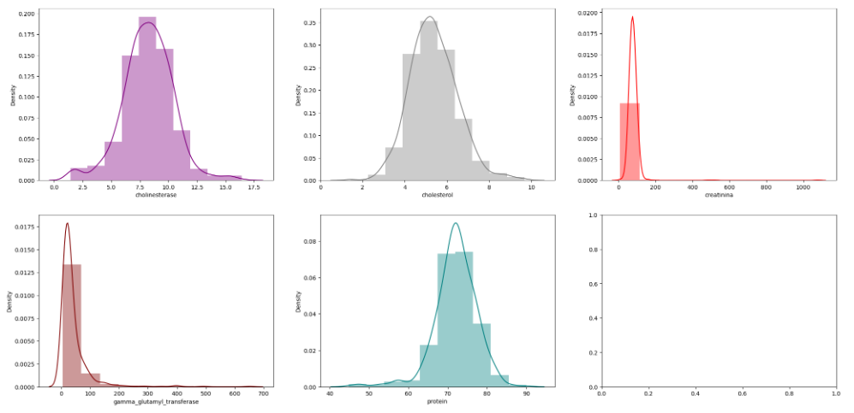
Distribution plots and Histograms
Most of the observations are not following Normal Distribution.

Slide 9
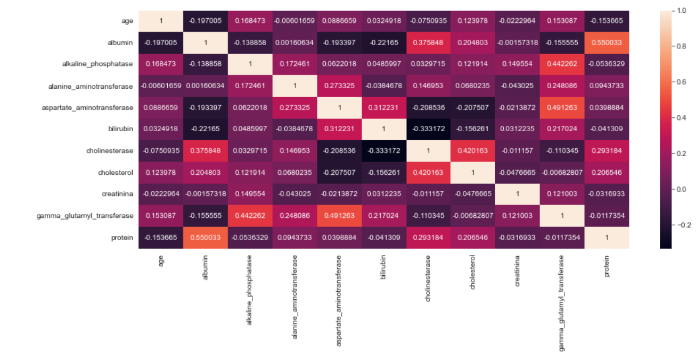
Heat map
Represents the correlation between 2 variables. We can see that protein and albumin (0.55) are having more correlation with each other than any other variables.

Slide 10
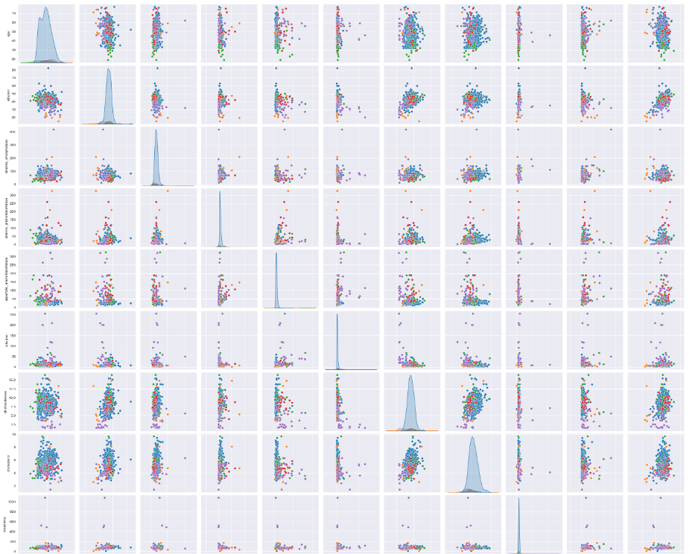
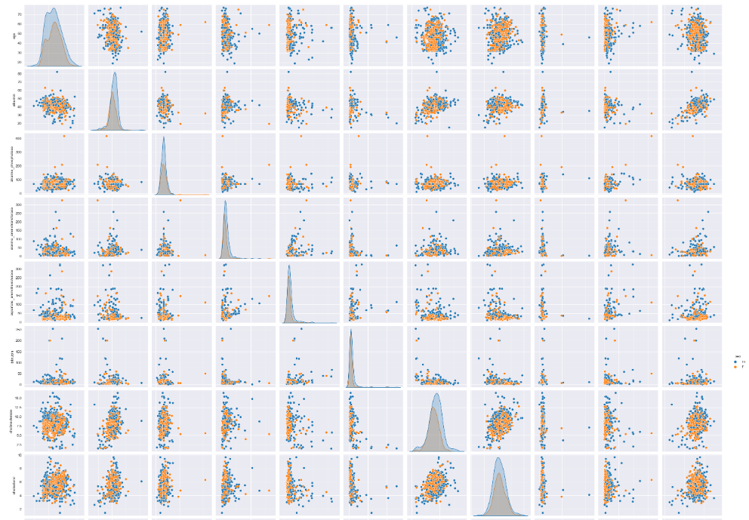
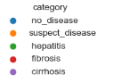
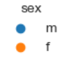
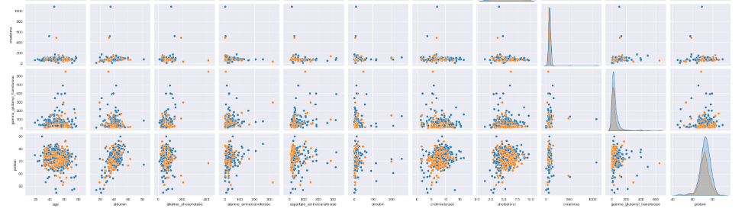
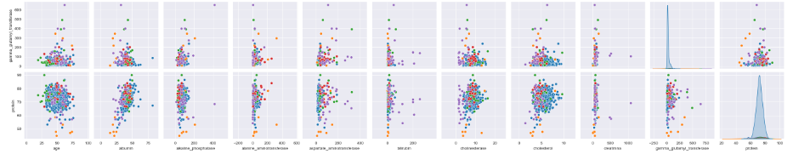
Pair plot
Pair plots with respect to category and sex

Slide 11
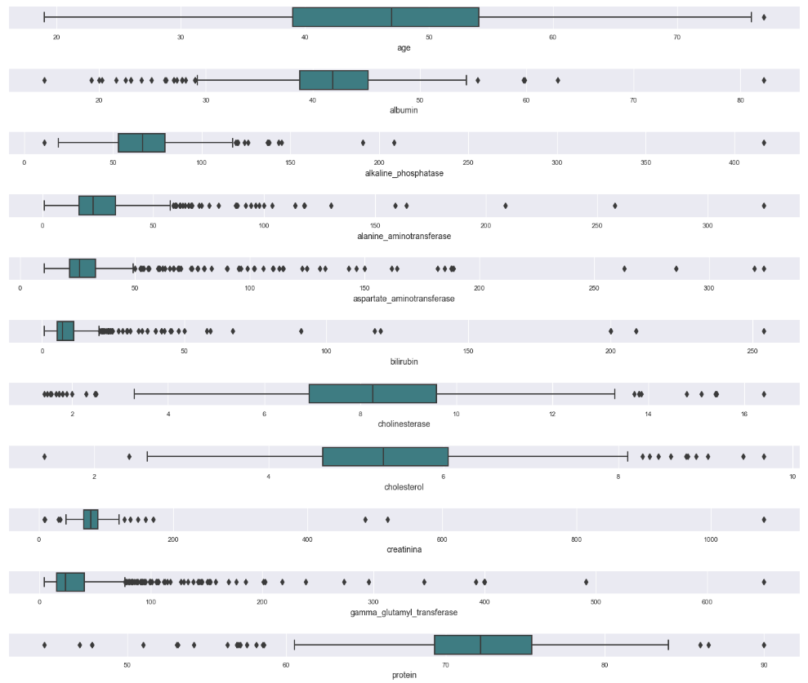
Box Plot
Box plot representing that there are outliers in all the columns of the data.

Slide 12
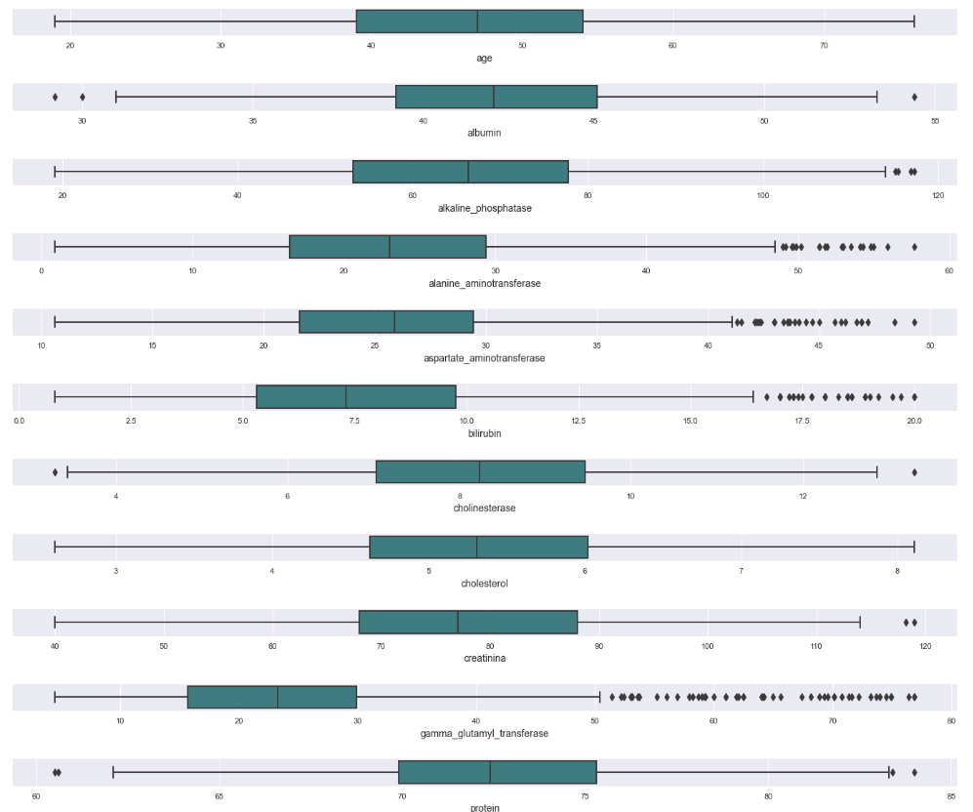
Box Plot
Box plot after applying the mean imputation technique for outliers.

Slide 13
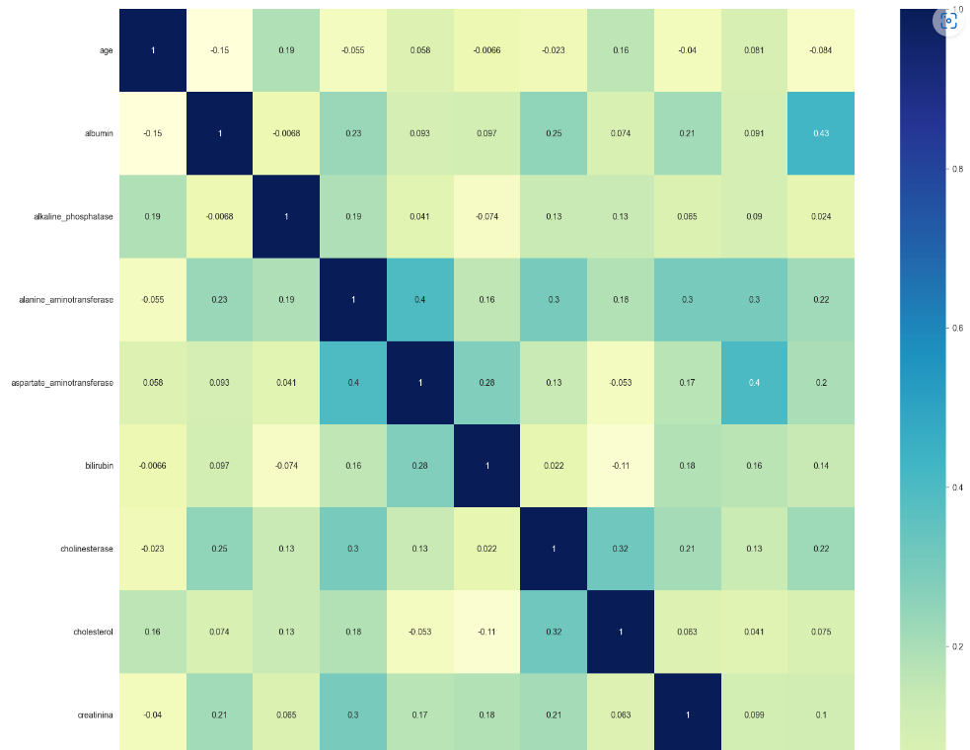
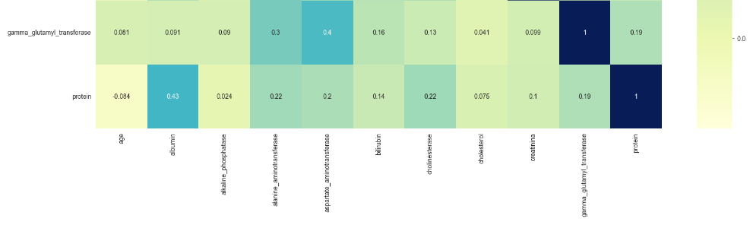
Feature Engineering
Here, we can observe that no feature is having the correlation greater than '0.5'. So need not drop any feature, as there is no multicollinearity between the variables.

Slide 14
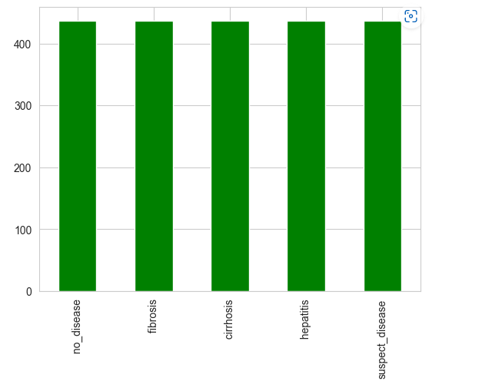
Data Balancing
As the given data is not balanced, we have balanced the training dataset using SMOTE (Synthetic Minority Over-Sampling technique)

Slide 15
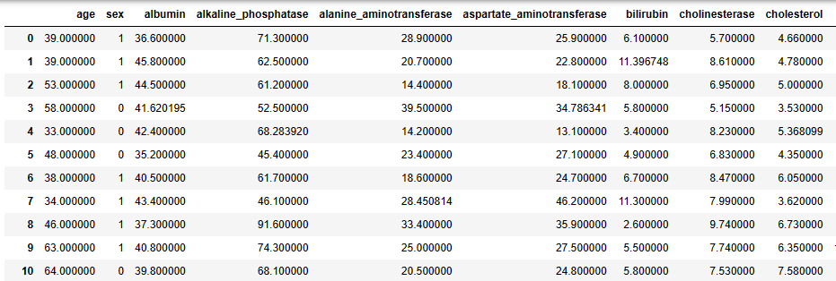
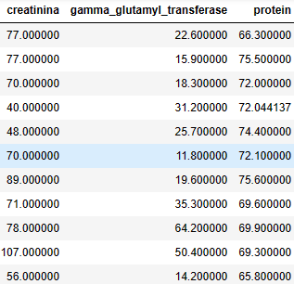
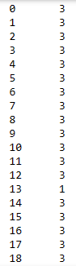
Training DATA
X-TRAIN
Y-TRAIN

Slide 16
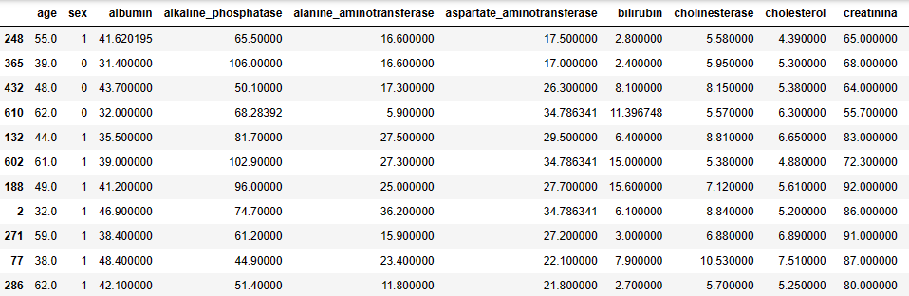
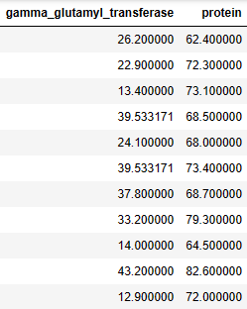
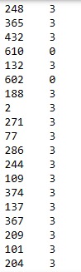
TESTING DATA
X-TEST
Y-TEST

Slide 17
MODEL BUILDING

Slide 18
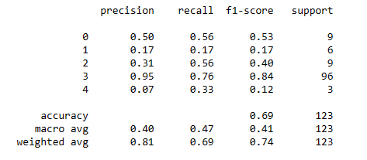
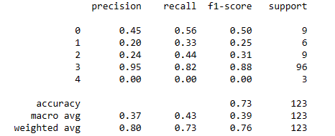
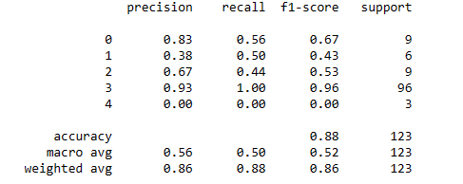
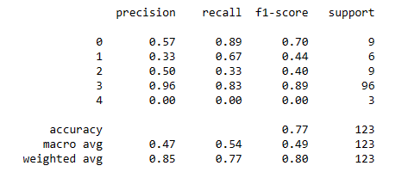
SUPPORT VECTOR MACHINE
LOGISTIC REGRESSION
Random forests
Stacking Ensemble model

Slide 19
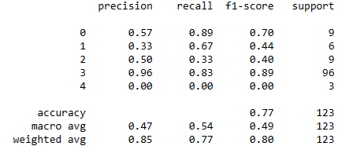
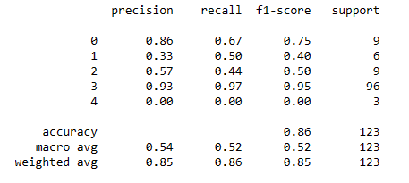
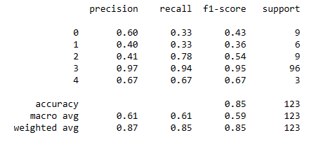
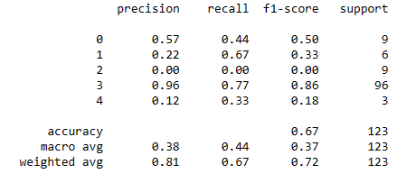
XTREME GRADIENT BOOSTING
light GRADIENT BOOSTING
NAÏVE BAYES
K-NEAREST NEIGHBOURS

Slide 20
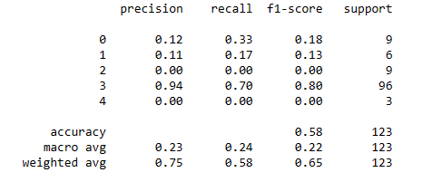
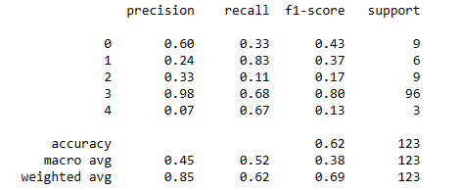
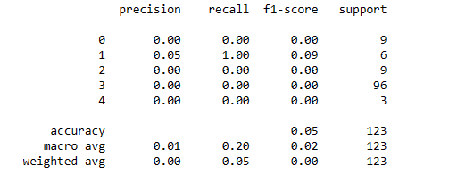
ADABOOST CLASSIFIER
DECISION TREES
ARTIFICIAL NEURAL NETWORK

Slide 21
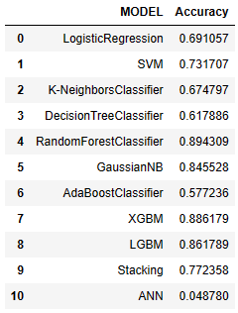
ACCURACY LIST OF ALL THE MODELS
Here we can observe that Random Forest Classifier model is having highest accuracy among all the other models. So we used Random Forest model for deployment.

Slide 22

MODEL DEPLOYMENT USING STREAMLIT

Slide 23
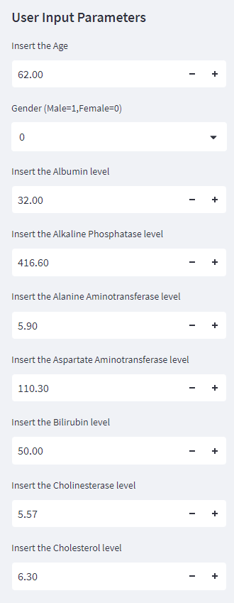
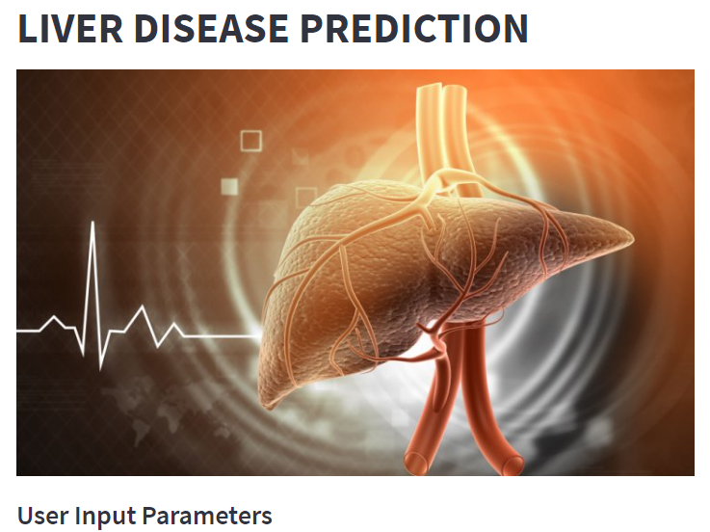
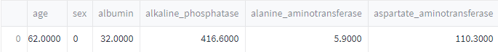
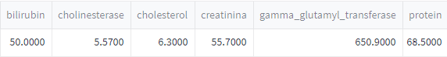
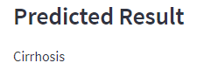
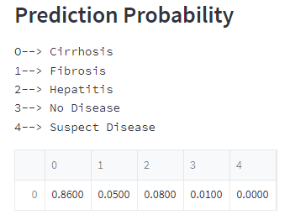
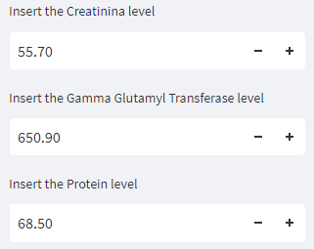

Slide 24
Challenges faced?
We have faced issues with
Outlier detection and imputation.
Balancing the data.
Model Building and Auto ML
How did you overcome?
We had overcome the challenges
Detected outliers using IQR formula and applied mean imputation technique for outliers.
Applied SMOTE technique to balance the data.
Used TPOT model for Auto ML

Slide 25
TEAM MEMBERS
BODDU NANDHINI
ERAGADINDLA DIVYA
AADI NAVEEN KUMAR
CHINTA VISHNU
NARA PRADEEP KUMAR
AKSHAY B R

Slide 26
THANK YOU

